Slide 1
Today
Overview of all the thermodynamic surfaces we’ve worked with this semester
Recap weeks 10-13

Slide 2
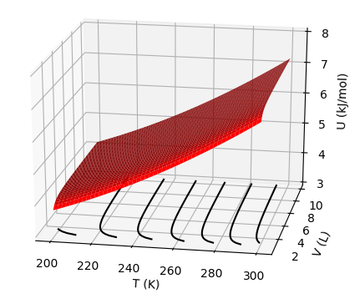


$U(T,V)$as a thermodynamic surface
$${\left(\frac{∂U}{∂T}\right)}_{V}$$
$${\left(\frac{∂U}{∂V}\right)}_{T}$$
$$dU=C_{V}dT+π_{T}dV$$

Slide 3
$U(T,V)$as a thermodynamic surface
$${\left(\frac{∂U}{∂T}\right)}_{V}$$
$${\left(\frac{∂U}{∂V}\right)}_{T}$$
$$dU=C_{V}dT+π_{T}dV$$

Slide 4
$U(T,V)$as a thermodynamic surface
$${\left(\frac{∂U}{∂T}\right)}_{V}$$
$${\left(\frac{∂U}{∂V}\right)}_{T}$$
$$dU=C_{V}dT+π_{T}dV$$

Slide 5
$U(T,V)$as a thermodynamic surface
$${\left(\frac{∂U}{∂T}\right)}_{V}$$
$${\left(\frac{∂U}{∂V}\right)}_{T}$$
$$dU=C_{V}dT+π_{T}dV$$
As temperature goes up, Total energy (U) goes up

Slide 6
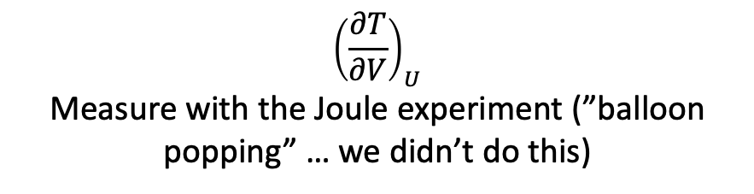
$U(T,V)$as a thermodynamic surface
$${\left(\frac{∂U}{∂T}\right)}_{V}$$
$${\left(\frac{∂U}{∂V}\right)}_{T}$$
$$dU=C_{V}dT+π_{T}dV$$
$${\left(\frac{∂T}{∂V}\right)}_{U}$$
Measure with the Joule experiment (”balloon popping” … we didn’t do this)

Slide 7
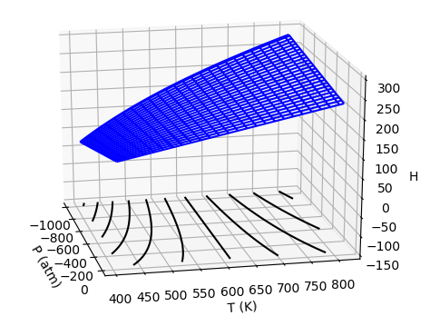


$H(T,P)$as a thermodynamic surface
$${\left(\frac{∂H}{∂T}\right)}_{P}$$
$${\left(\frac{∂H}{∂P}\right)}_{T}$$
Pressure
Temperature
$$dH=C_{P}dT+μ_{T}dP$$

Slide 8
$H(T,P)$as a thermodynamic surface
$${\left(\frac{∂H}{∂T}\right)}_{P}$$
$${\left(\frac{∂H}{∂P}\right)}_{T}$$
Pressure
Temperature
$$dH=C_{P}dT+μ_{T}dP$$

Slide 9
$H(T,P)$as a thermodynamic surface
$${\left(\frac{∂H}{∂T}\right)}_{P}$$
$${\left(\frac{∂H}{∂P}\right)}_{T}$$
Pressure
Temperature
$$dH=C_{P}dT+μ_{T}dP$$
As temperature goes up, Enthalpy (H) goes up

Slide 10
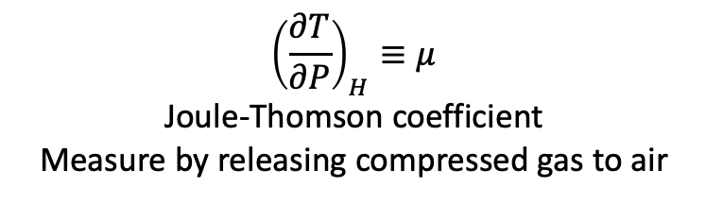
$H(T,P)$as a thermodynamic surface
$${\left(\frac{∂H}{∂T}\right)}_{P}$$
$${\left(\frac{∂H}{∂P}\right)}_{T}$$
Pressure
Temperature
$$dH=C_{P}dT+μ_{T}dP$$
$${\left(\frac{∂T}{∂P}\right)}_{H}≡μ$$
Joule-Thomson coefficient
Measure by releasing compressed gas to air

Slide 11
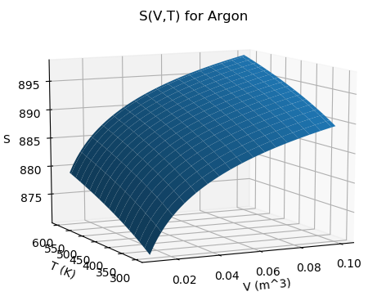



$S(T,V)$as a thermodynamic surface
$${\left(\frac{∂S}{∂T}\right)}_{V}$$
$${\left(\frac{∂S}{∂V}\right)}_{T}$$
Temperature
Volume
$$dS=\frac{C_{V}}{T}dT+\frac{α_{P}}{κ_{T}}dV$$

Slide 12
$S(T,V)$as a thermodynamic surface
$${\left(\frac{∂S}{∂T}\right)}_{V}$$
$${\left(\frac{∂S}{∂V}\right)}_{T}$$
Temperature
Volume
$$dS=\frac{C_{V}}{T}dT+\frac{α_{P}}{κ_{T}}dV$$
As volume goes up, Entropy (S) goes up

Slide 13
$S(T,V)$as a thermodynamic surface
$${\left(\frac{∂S}{∂T}\right)}_{V}$$
$${\left(\frac{∂S}{∂V}\right)}_{T}$$
Temperature
Volume
$$dS=\frac{C_{V}}{T}dT+\frac{α_{P}}{κ_{T}}dV$$
As temperature goes up, Entropy (S) goes up

Slide 14
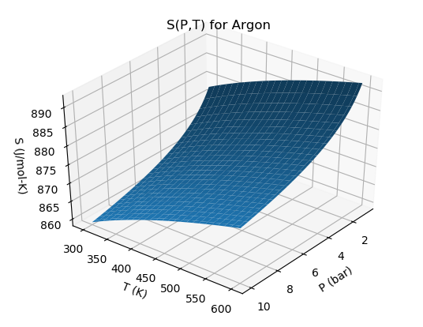



$S(T,P)$as a thermodynamic surface
$${\left(\frac{∂S}{∂P}\right)}_{T}$$
← Pressure
$${\left(\frac{∂S}{∂T}\right)}_{P}$$
Temperature
$$dS=\frac{C_{P}}{T}dT−α_{P}VdP$$

Slide 15
$S(T,P)$as a thermodynamic surface
$${\left(\frac{∂S}{∂P}\right)}_{T}$$
← Pressure
$${\left(\frac{∂S}{∂T}\right)}_{P}$$
Temperature
$$dS=\frac{C_{P}}{T}dT−α_{P}VdP$$
As pressure goes up, Entropy (S) goes down

Slide 16
$S(T,P)$as a thermodynamic surface
$${\left(\frac{∂S}{∂P}\right)}_{T}$$
← Pressure
$${\left(\frac{∂S}{∂T}\right)}_{P}$$
Temperature
$$dS=\frac{C_{P}}{T}dT−α_{P}VdP$$
As temperature goes up, Entropy (S) goes up

Slide 17
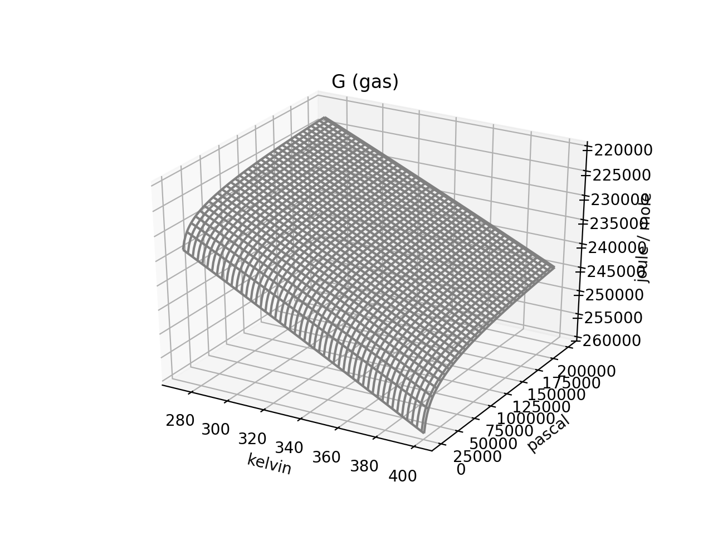


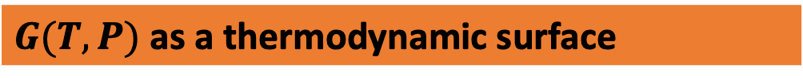
$G(T,P)$as a thermodynamic surface
$${\left(\frac{∂G}{∂T}\right)}_{P}$$
$${\left(\frac{∂G}{∂P}\right)}_{T}$$
Pressure
Temperature
$$dG=−SdT+VdP$$

Slide 18
$G(T,P)$as a thermodynamic surface
$${\left(\frac{∂G}{∂T}\right)}_{P}$$
$${\left(\frac{∂G}{∂P}\right)}_{T}$$
Pressure
Temperature
As pressure goes up, Gibbs energy (G) goes up
$$dG=−SdT+VdP$$

Slide 19
$G(T,P)$as a thermodynamic surface
$${\left(\frac{∂G}{∂T}\right)}_{P}$$
$${\left(\frac{∂G}{∂P}\right)}_{T}$$
Pressure
Temperature
$$dG=−SdT+VdP$$
As temperature goes up, Gibbs energy (G) goes down

Slide 20
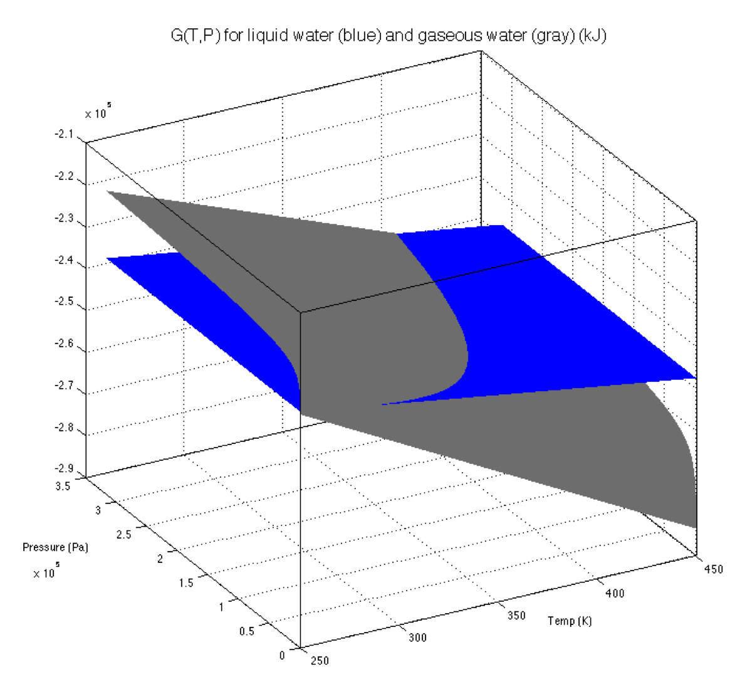

Intersecting $G(T,P)$ thermodynamic surfaces
vapor
Liquid
← Pressure
Temperature

Slide 21
Intersecting $G(T,P)$ thermodynamic surfaces
vapor
Liquid
← Pressure
Temperature
Along a phase boundary

Slide 22
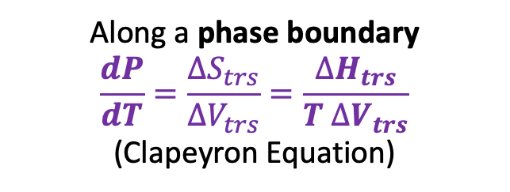
Intersecting $G(T,P)$ thermodynamic surfaces
vapor
Liquid
← Pressure
Temperature
Along a phase boundary
$$\frac{dP}{dT}=\frac{∆S_{trs}}{∆V_{trs}}=\frac{∆H_{trs}}{T ∆V_{trs}}$$
(Clapeyron Equation)

Slide 23
Summary of measurable quantities

Slide 24
Week 10 – Entropy as a measure of choice (of where to go in space)
More choice about where to be → higher S

Slide 25
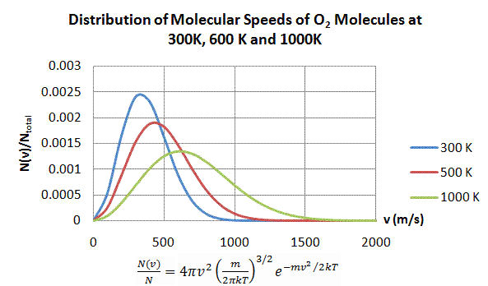
Week 10 – Entropy as a measure of choice (of how to distribute energy)
More choice about where to distribute energy → higher S

Slide 26
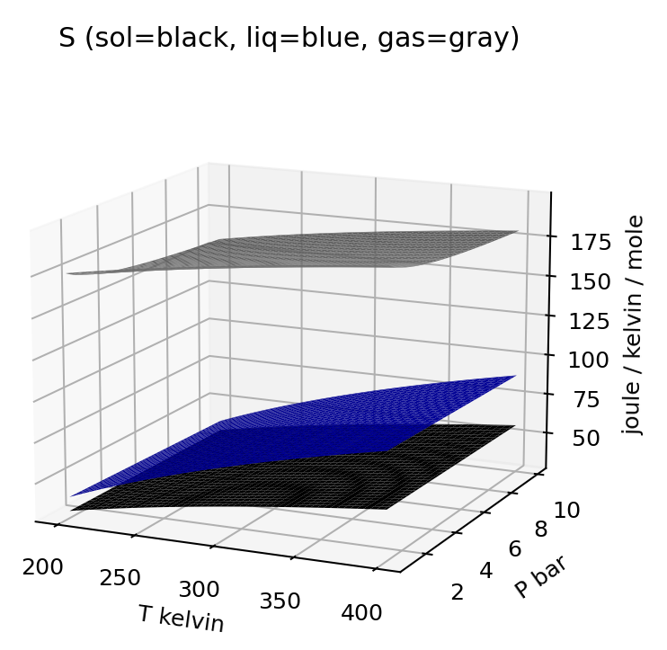

Week 10 – Entropy of different phases in T,P state space
$$dS=\frac{C_{P}}{T}dT−α_{P}VdP$$

Slide 27
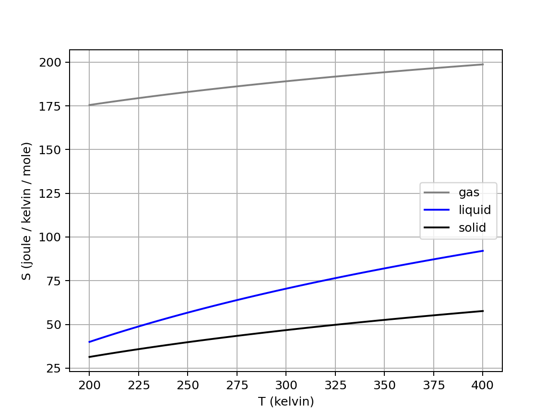
Week 10 – Isobars of the entropy of water at $P≈1 bar$

Slide 28
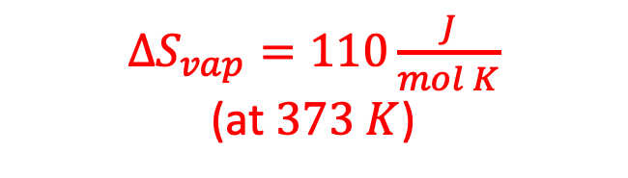
Week 10 – Entropy of vaporization of water
$∆S_{vap}=110\frac{J}{mol K}$
(at $373 K$)

Slide 29
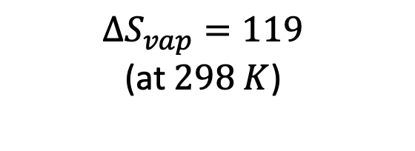
Week 10 – Entropy of vaporization of water
$∆S_{vap}=110\frac{J}{mol K}$
(at $373 K$)
$$∆S_{vap}=119$$
(at $298 K$)

Slide 30
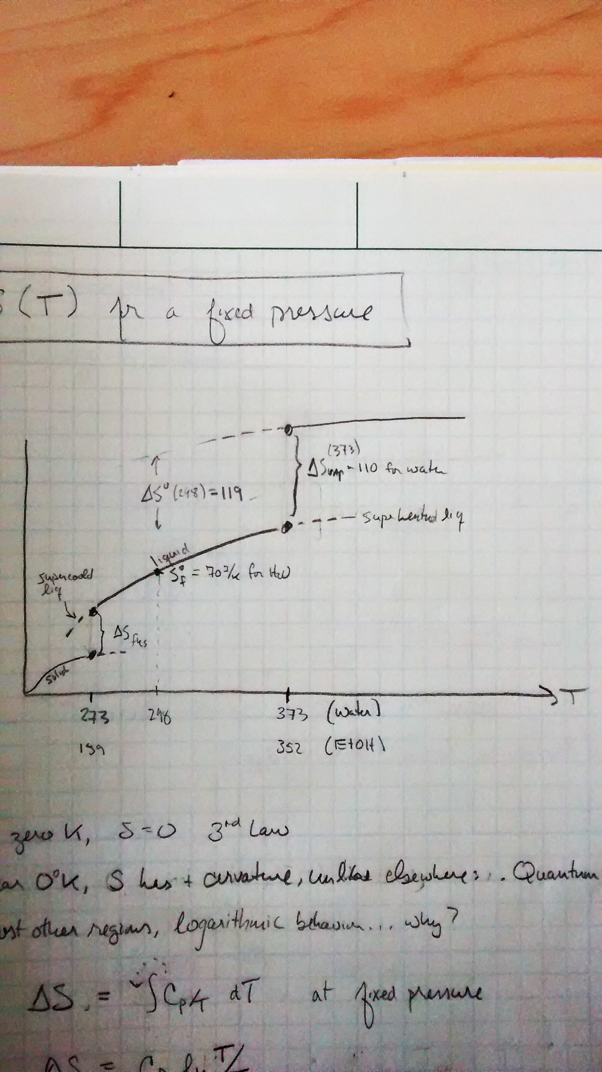
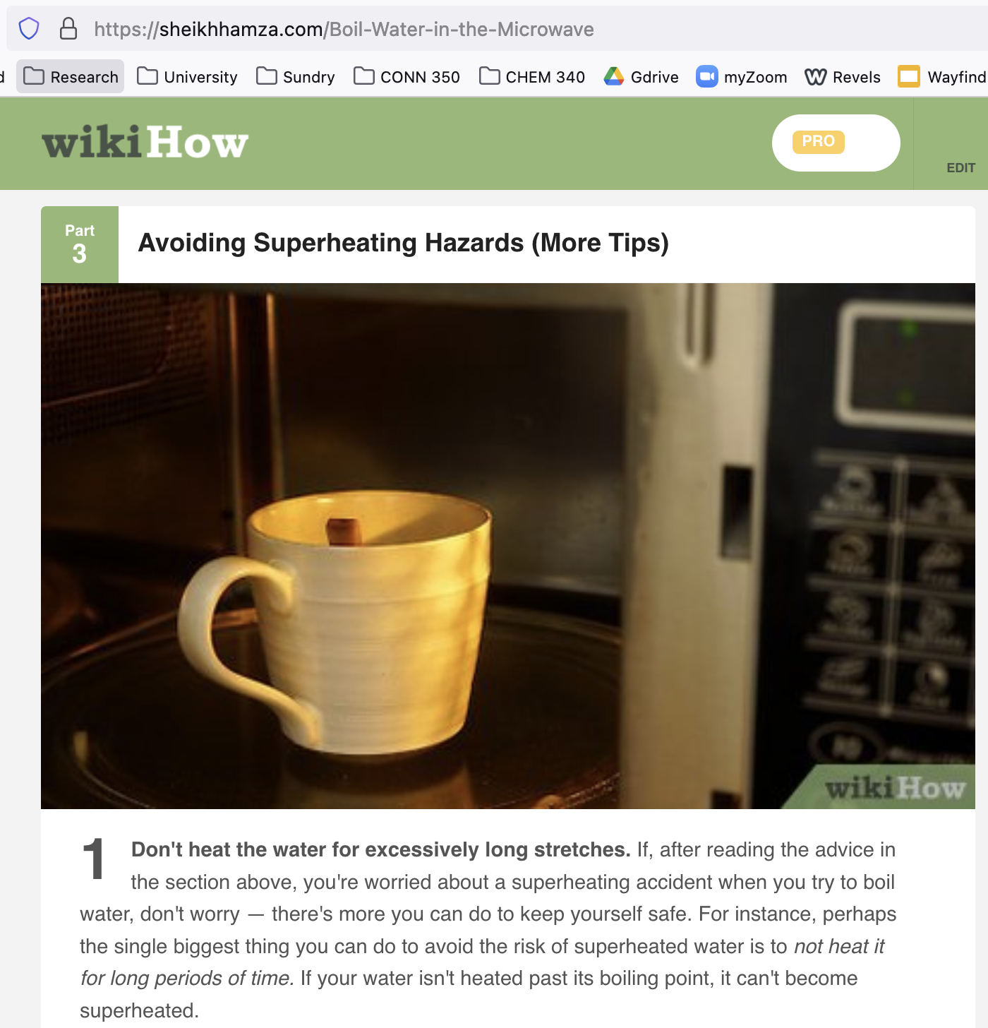
Week 10 – Supercooling and superheating
S

Slide 31
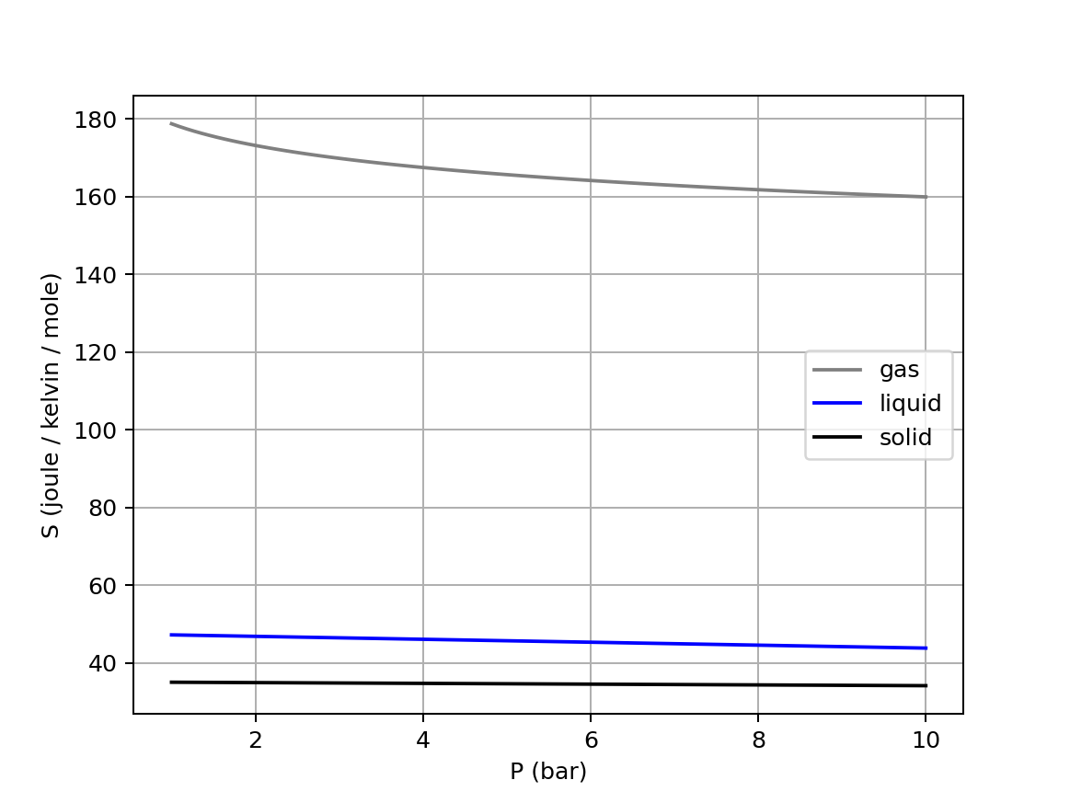

Week 10 – Isotherms of the entropy of water ($T≈298 K$)
$$dS=\frac{C_{P}}{T}dT−α_{P}VdP$$

Slide 32
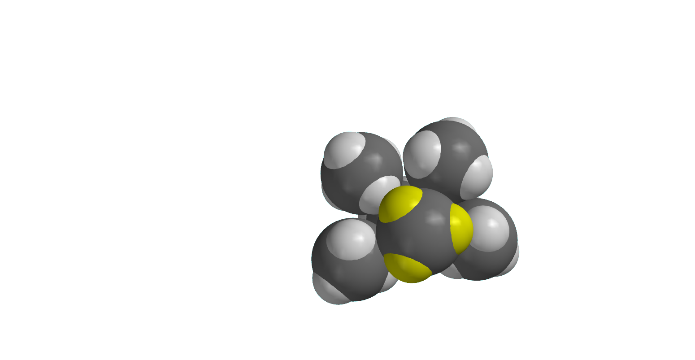
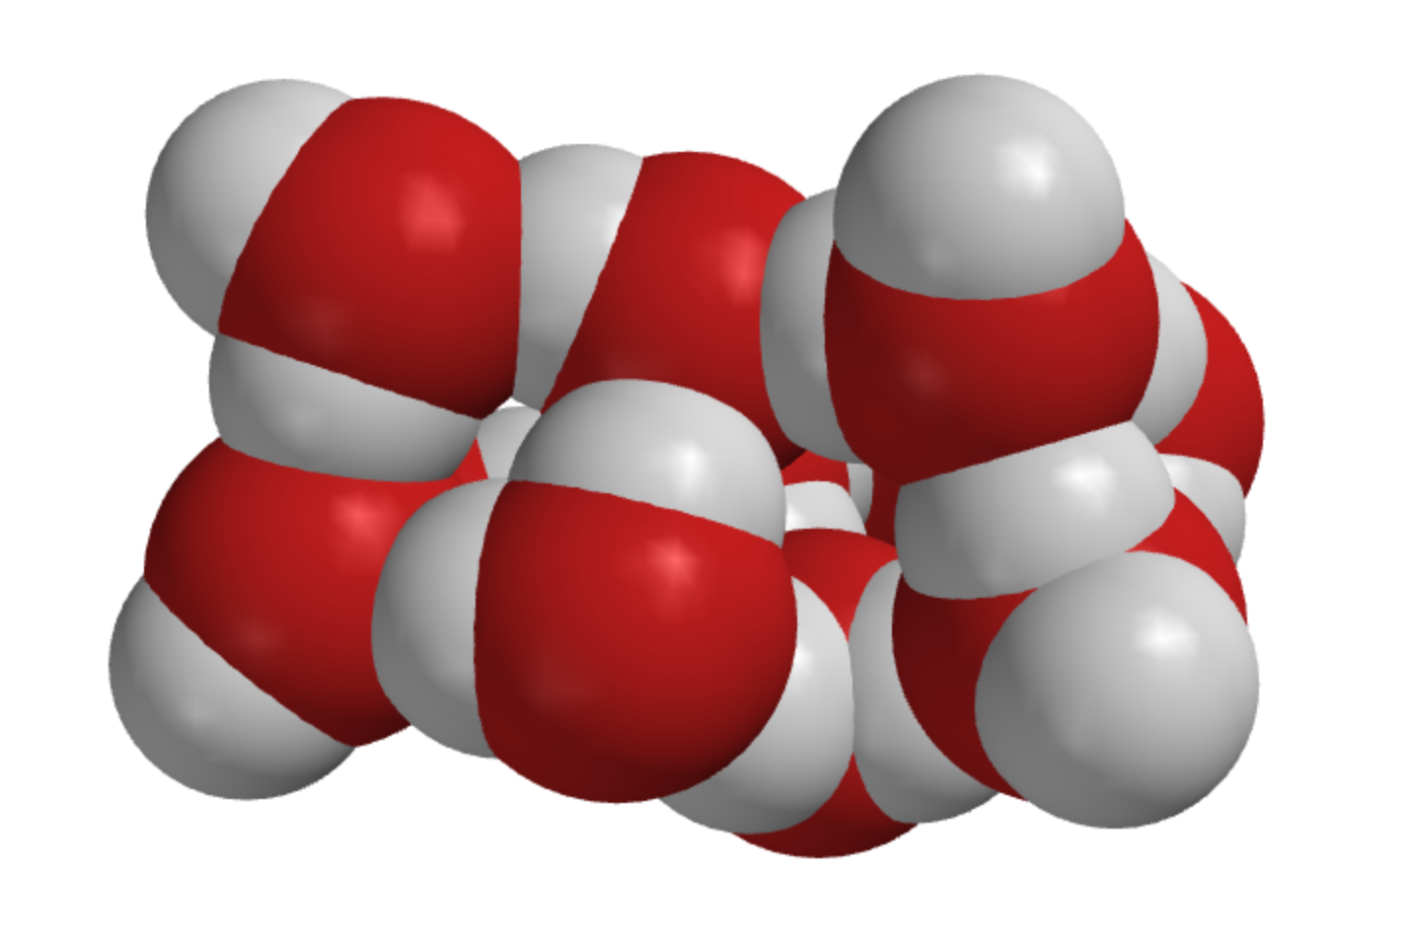
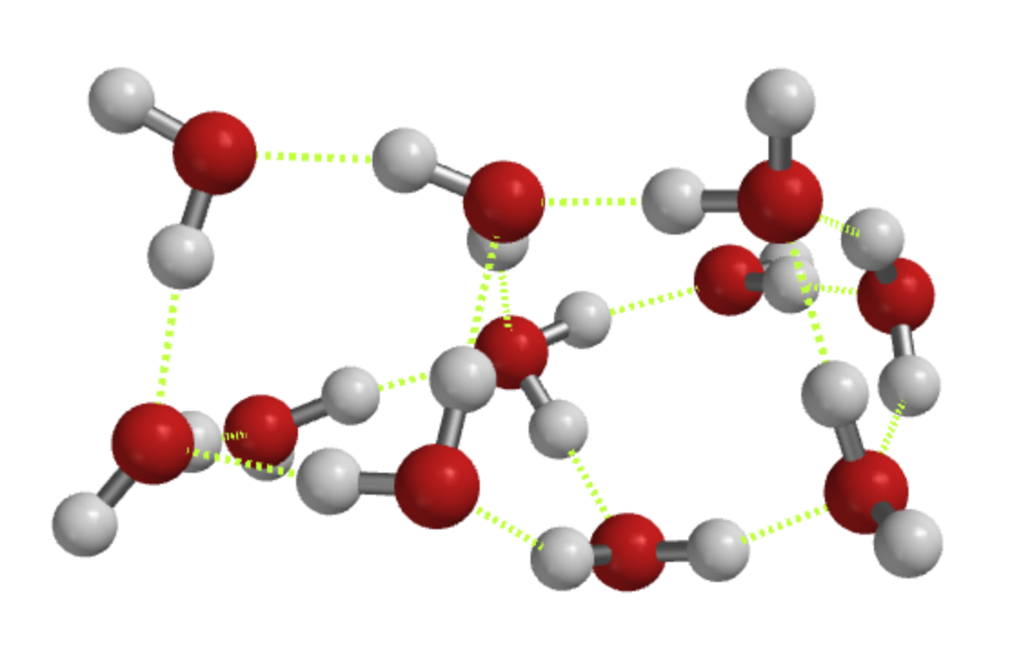
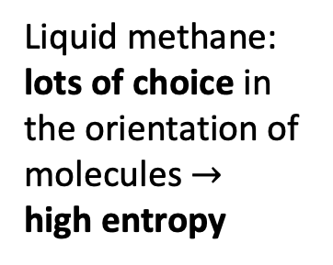
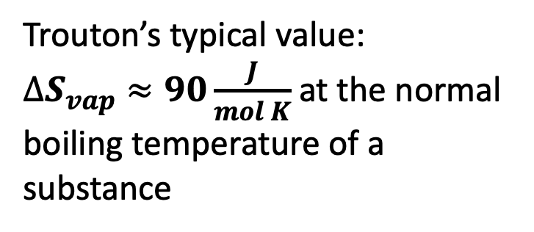
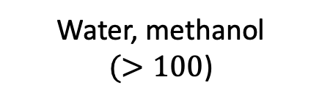
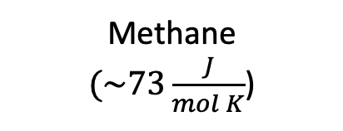
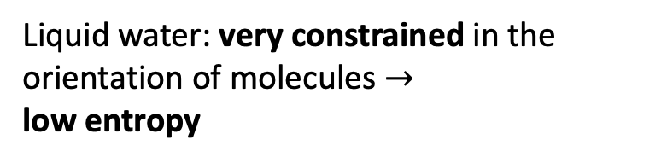
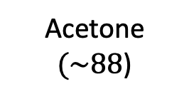
Week 10 – Why $∆S_{vap}$ of water is so big
Trouton’s typical value:
$∆S_{vap}≈90\frac{J}{mol K}$ at the normal boiling temperature of a substance
Methane
$(\sim 73\frac{J}{mol K}$)
Acetone
$(\sim 88$)
Water, methanol
$(>100$)
Liquid water: very constrained in the orientation of molecules $→$
low entropy
Liquid methane: lots of choice in the orientation of molecules $→$
high entropy
Notes:
https://slideplayer.com/slide/7362502/

Slide 33
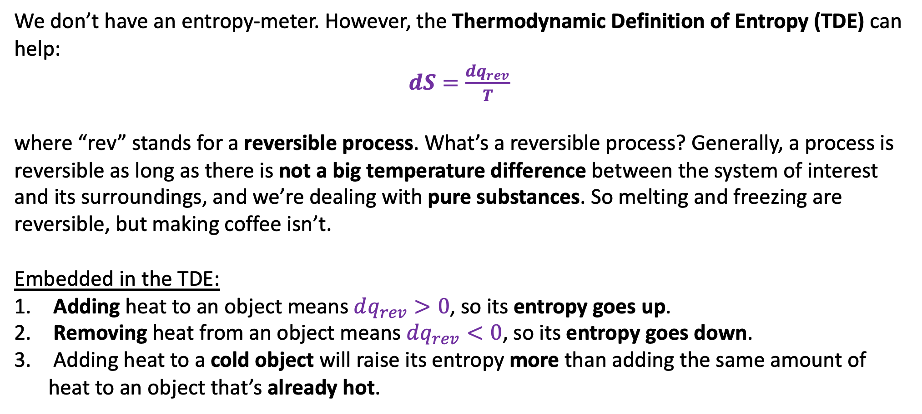
Week 10 – Thermodynamic Definition of Entropy (TDE)
We don’t have an entropy-meter. However, the Thermodynamic Definition of Entropy (TDE) can help:
$dS=\frac{dq_{rev}}{T}$
where “rev” stands for a reversible process. What’s a reversible process? Generally, a process is reversible as long as there is not a big temperature difference between the system of interest and its surroundings, and we’re dealing with pure substances. So melting and freezing are reversible, but making coffee isn’t.
Embedded in the TDE:
Adding heat to an object means $dq_{rev}>0$, so its entropy goes up.
Removing heat from an object means $dq_{rev}<0$, so its entropy goes down.
Adding heat to a cold object will raise its entropy more than adding the same amount of heat to an object that’s already hot.

Slide 34
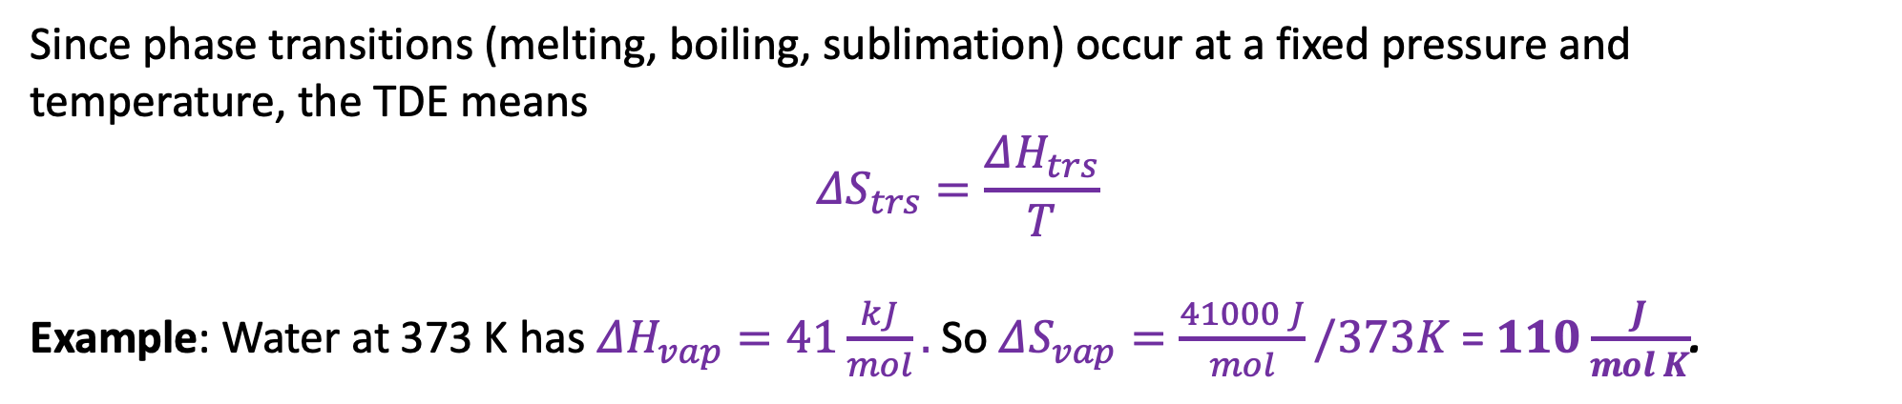
Week 10 – A great use of the TDE: to measure entropies of phase transitions
Since phase transitions (melting, boiling, sublimation) occur at a fixed pressure and temperature, the TDE means
$$ΔS_{trs}=\frac{ΔH_{trs}}{T}$$
Example: Water at 373 K has $ΔH_{vap}=41\frac{kJ}{mol}.$So $ΔS_{vap}=\frac{41000 J}{mol}/373K$ = $110\frac{J}{mol K}$.

